Slide 1
HARDWARE FELLOWSHIP 2023
DAY 4
INSTRUCTOR: SUSHANT PANDEY

Slide 2
WIRELESS COMMUNICATION

Slide 3
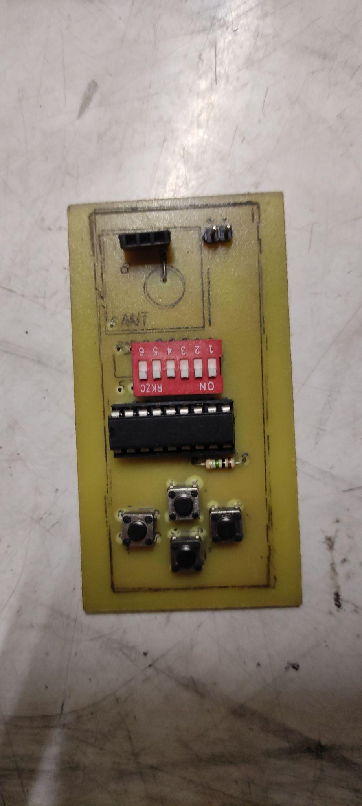
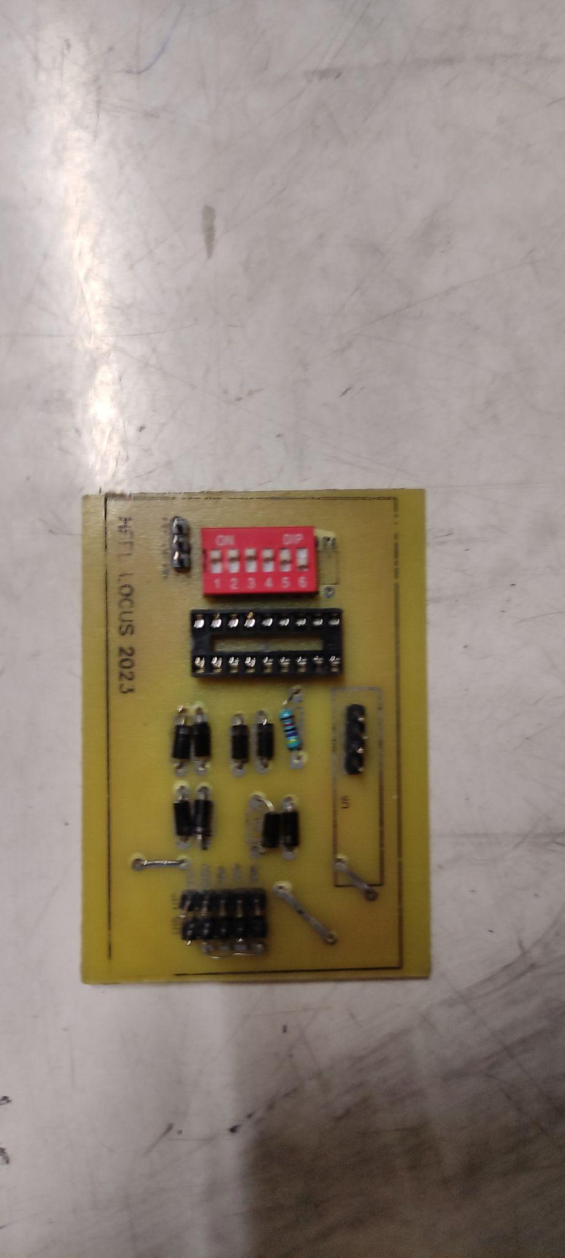
Encoder Logic
Decoder Logic

Slide 4
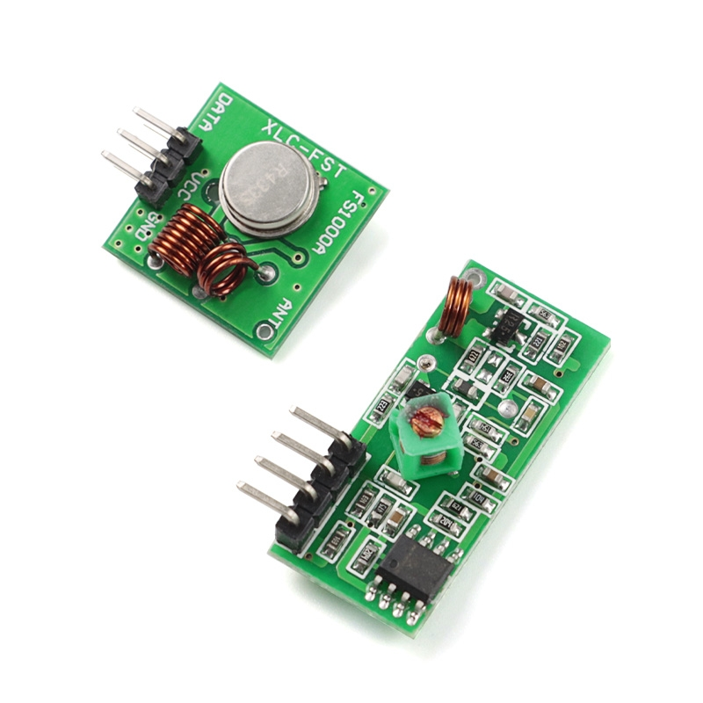
RF 433 Mhz Module

Slide 5
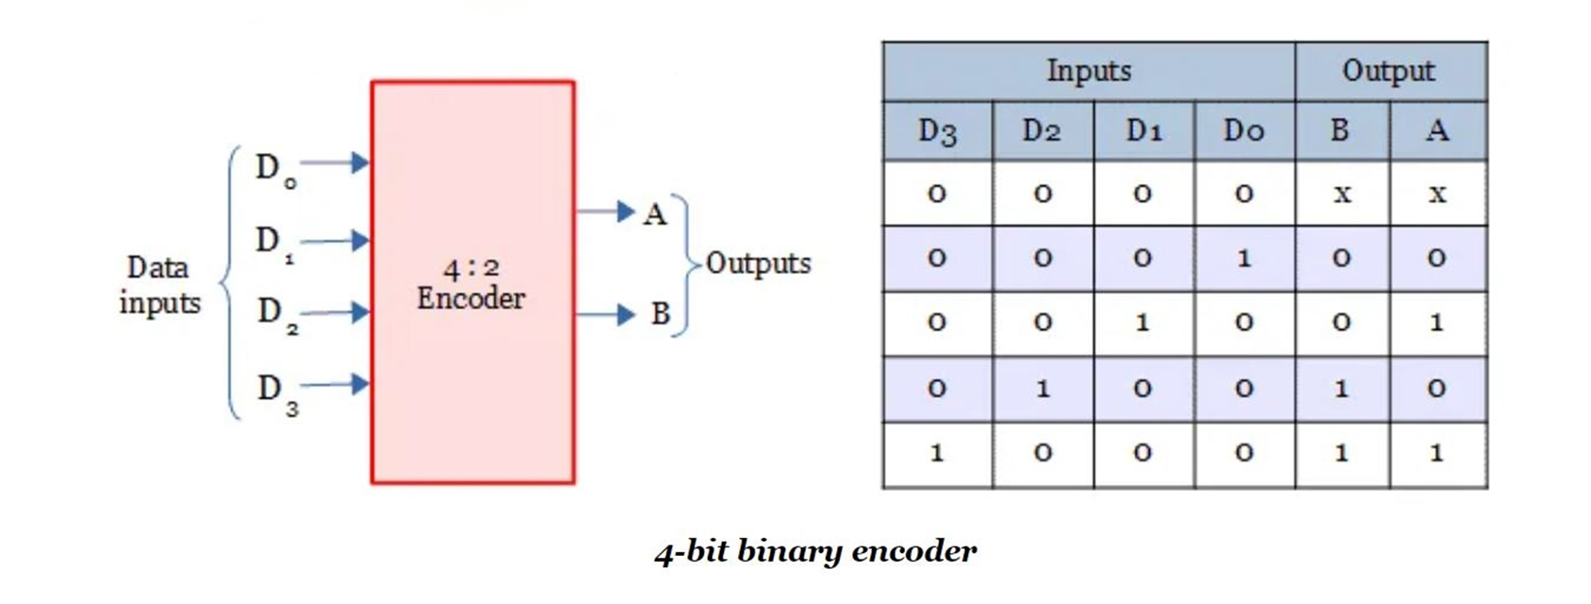

Slide 6
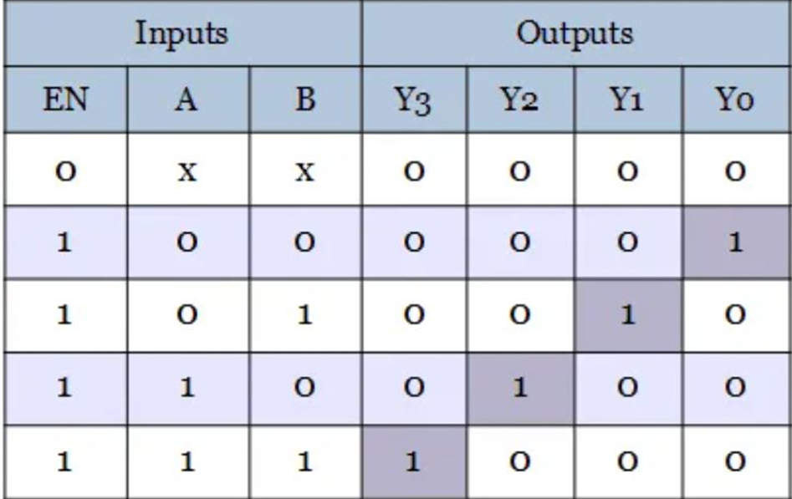
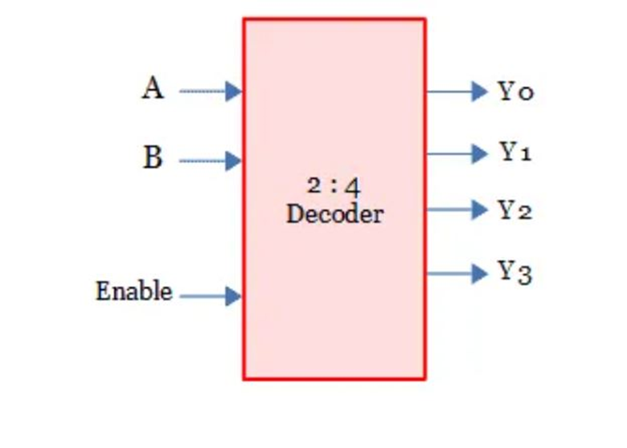

Slide 7
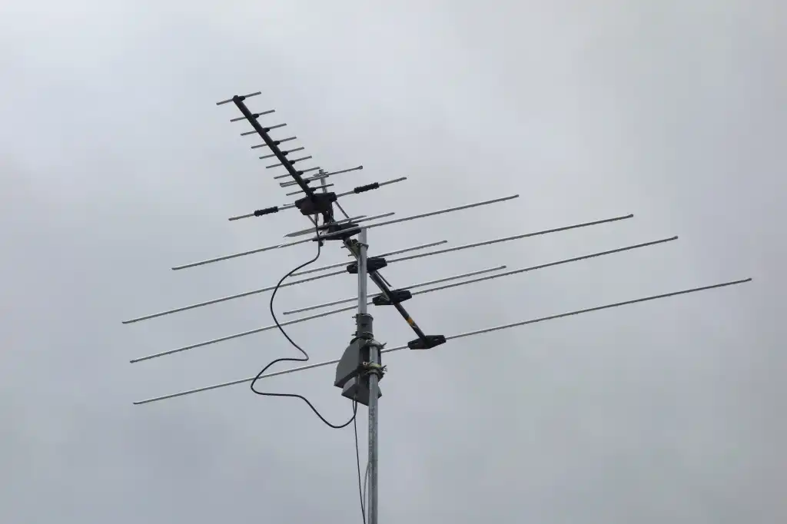
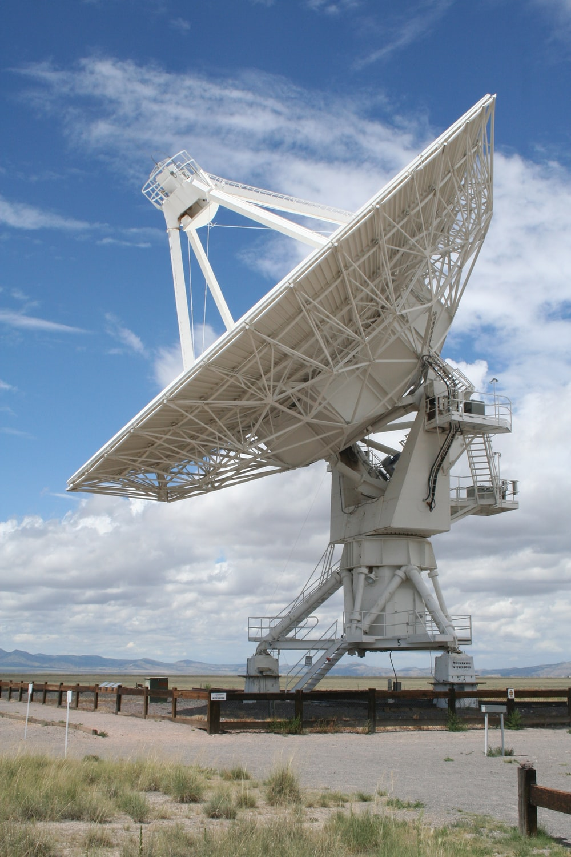
Receiver
Antennas are electrical devices that transform the electrical signals to radio signals in the form of Electromagnetic (EM) Waves and vice versa. These Electromagnetic Waves propagates through space.
Transmitter

Slide 8
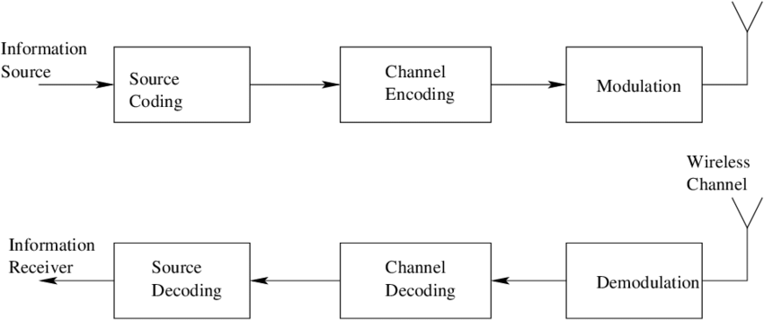
WIRELESS COMMUNICATION

Slide 9
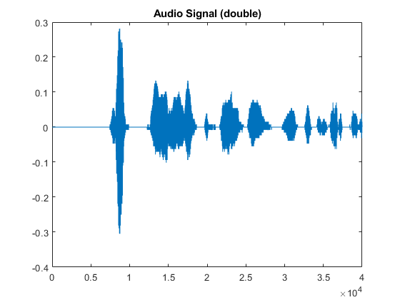
Source encoding aims to convert information waveforms (text, audio, image, video, etc.) in to a suitable form for applying signal processing techniques.
(Remove redundant information)

Slide 10
The channel encoder, does the coding for error correction. During the transmission of the signal, due to the noise in the channel, the signal may get altered and hence to avoid this, the channel encoder adds some redundancy.

Slide 11
Modulation is the process of converting data into radio waves by adding information to an electronic or optical carrier signal.
(process of encoding information from a message source in a way that is suitable for transmission)
MODULATION TECHNIQUE: ASK, PSK, FSK, etc.

Slide 12
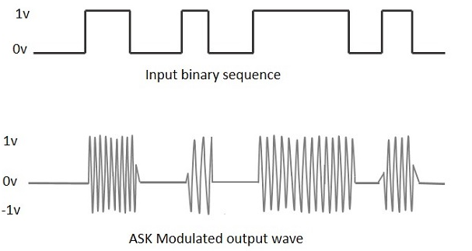
ASK (Amplitude Shift Keying (Modulation)

Slide 13
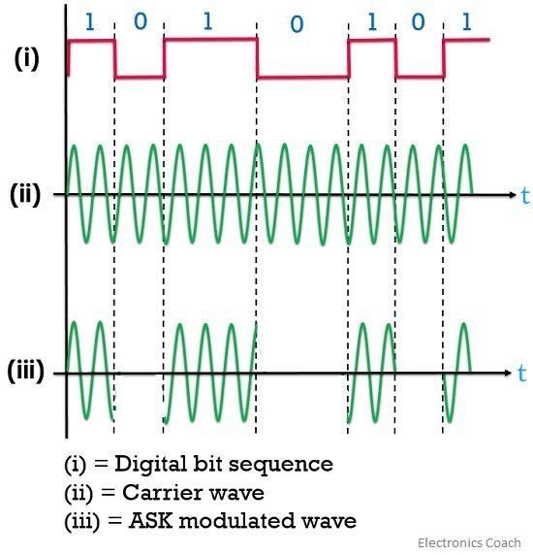
ASK (Amplitude Shift Keying (Modulation)

Slide 14
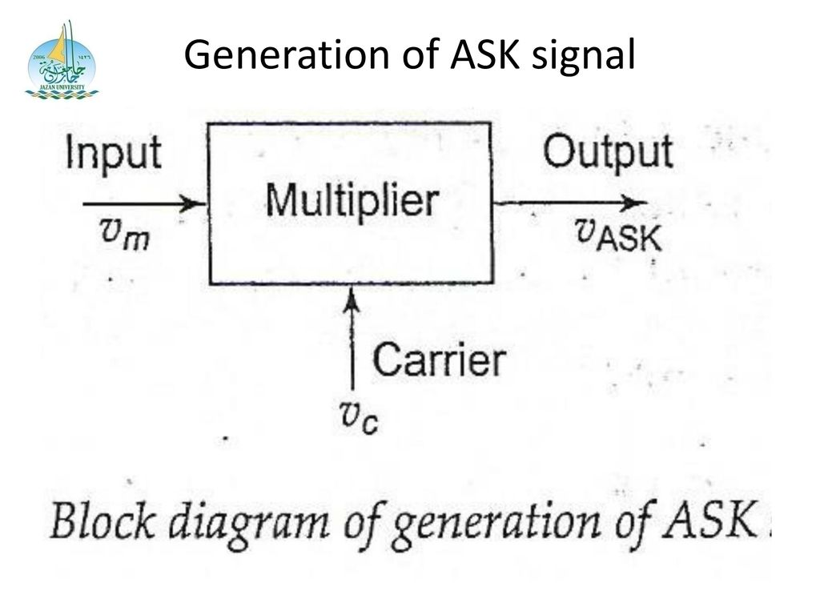
Generation of ASK

Slide 15
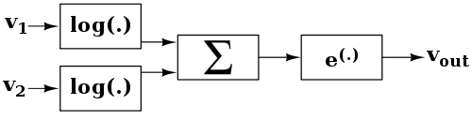
Multiplier
log(xy) = log(x) + log(y)

Slide 16
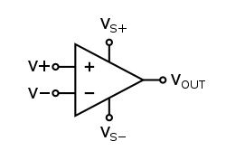
Op amp
An operational amplifier (op amp) is an analog circuit block that takes a differential voltage input and produces a single-ended voltage output.

Slide 17
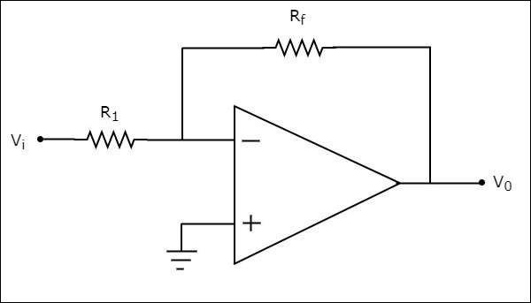
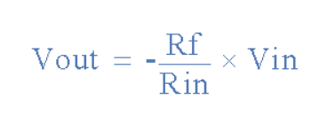
Inverting Op amp

Slide 18
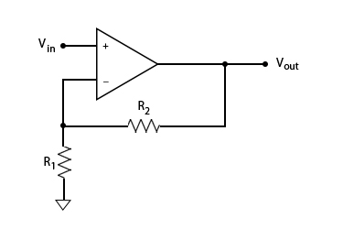
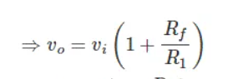
Non-inverting Op amp

Slide 19
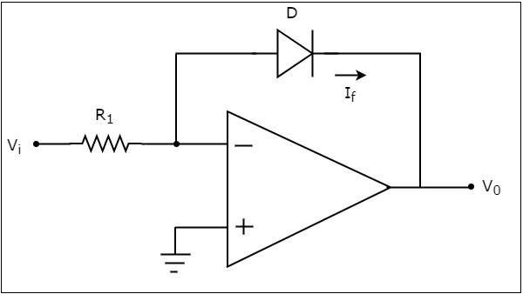
Log Amplifier
log(xy) = log(x) + log(y)
A logarithmic amplifier, or a log amplifier, is an electronic circuit that produces an output that is proportional to the logarithm of the applied input.

Slide 20
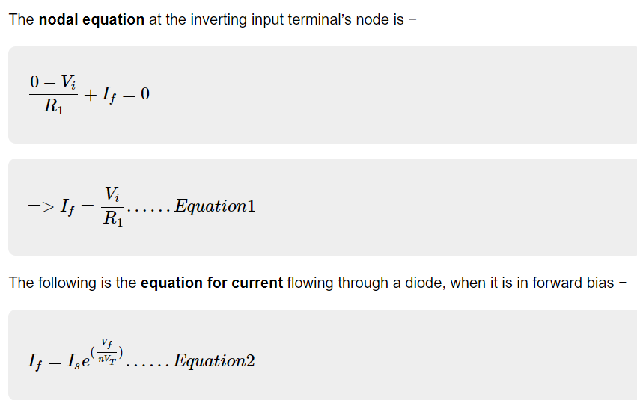
Log Amplifier

Slide 21
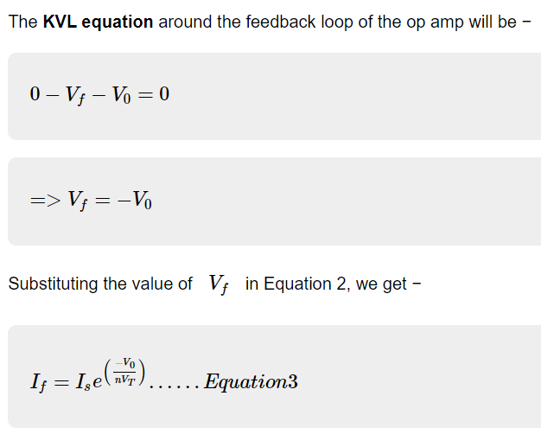
Log Amplifier

Slide 22
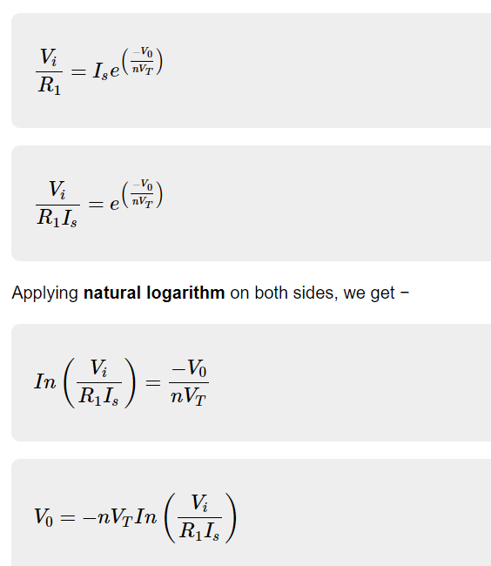
Log Amplifier

Slide 23
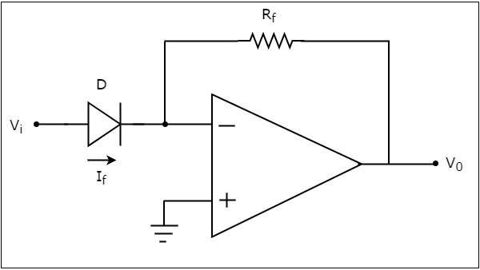
AntiLog Amplifier

Slide 24
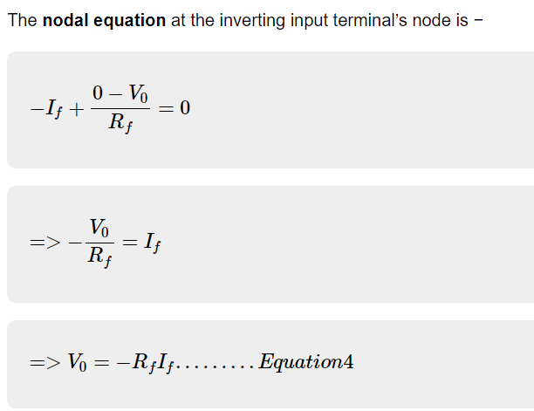
AntiLog Amplifier

Slide 25
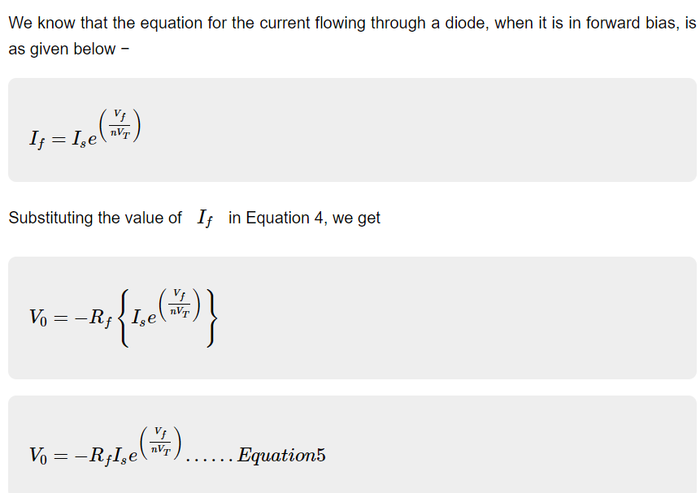
AntiLog Amplifier

Slide 26
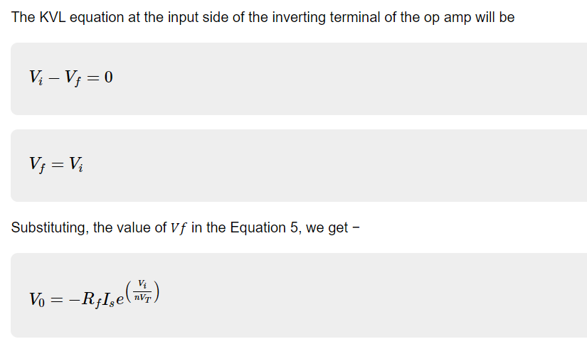
AntiLog Amplifier

Slide 27
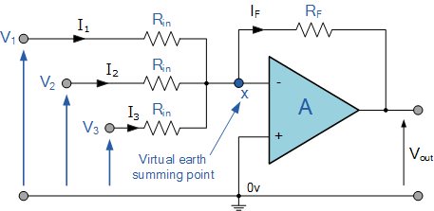
OPamp as Summer

Slide 28
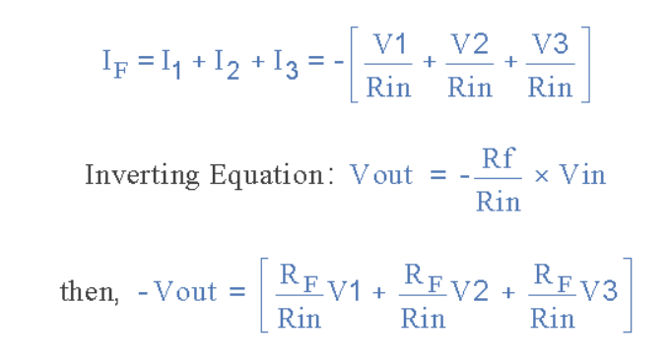
OPamp as Summer

Slide 29
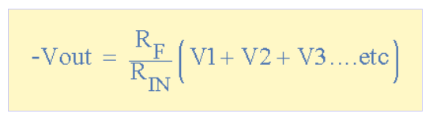
OPamp as Summer

Slide 30
Multiplier

Slide 31
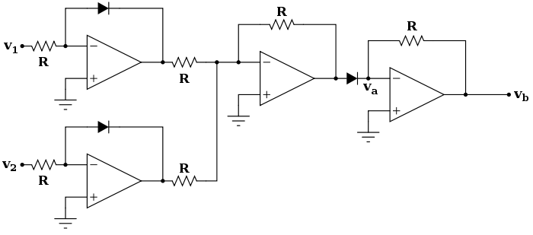
Multiplier Using Opamp

Slide 32
Generation of ASK

Slide 33
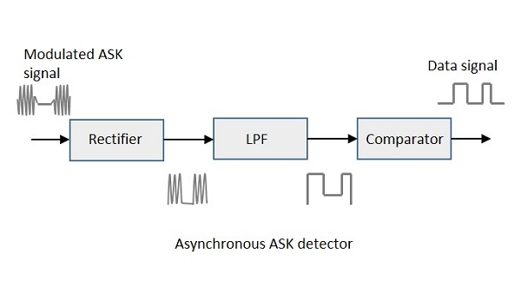
Non-Coherent Detection of ASK

Slide 34
RF 433 Mhz Module
Wireless (RF) Simplex Transmitter and Receiver
Receiver Operating Voltage: 3V to 12V
Receiver Operating current: 5.5mA
Operating frequency: 433 MHz
Transmission Distance: 3 meters (without antenna) to 100 meters (maximum)
Modulating Technique: ASK (Amplitude shift keying)
Data Transmission speed: 10Kbps
Circuit type: Saw resonator

Slide 35
RF 433 Mhz Module

Slide 36
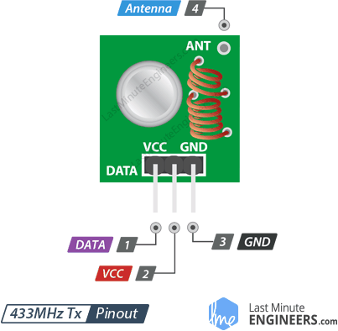
RF 433 Mhz Transmitter Pin Layout

Slide 37
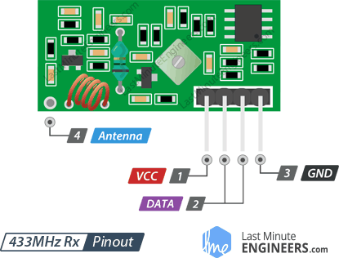
RF 433 Mhz Receiver Pin Layout

Slide 38
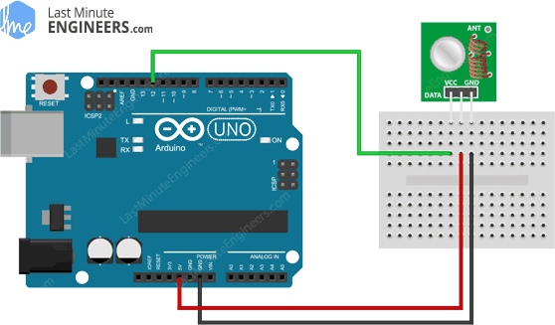

Slide 39
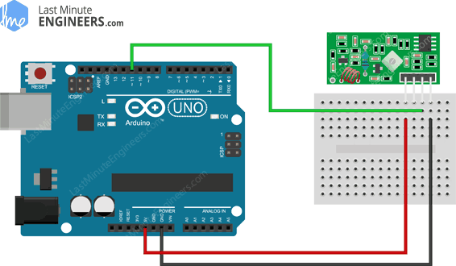

Slide 40
Marconi Antenna
-17.3 cm piece of solid wire

Slide 41
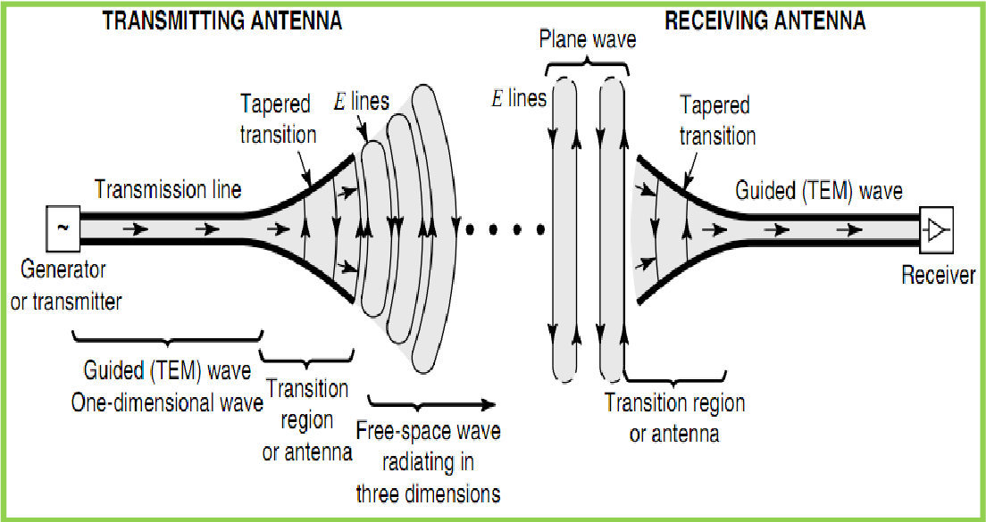

Slide 42
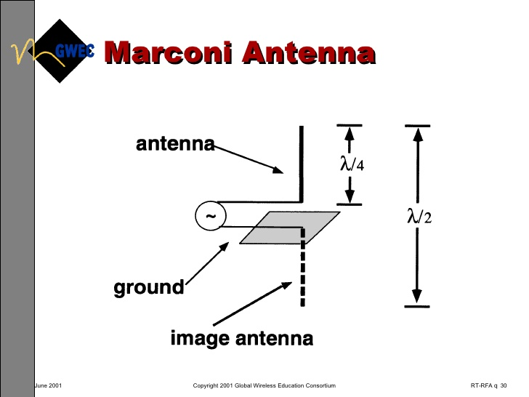

Slide 43
THANK YOU

